Slide 1
Digital Blogs
Dr. Sumner
https://mrsdiannasumner.weebly.com/

Slide 2
Rational (The Purpose)
The rational (purpose) behind this activity is for Mr. Harkless and myself to get to know you better. You will be creating a digital blog about yourself through Power-Point. Follow the prompts for each slide and be as creative as you would like. Be appropriate! Inappropriateness will cause you to lose 50% of your grade.

Slide 3
Rubric
Criteria |  | Proficient (42-38 pts) | Competent (37-34 pts) | Novice (33-30 pts) | Insufficient (29-0 pts)
Basic Introductions | 3 pts | Presentation includes all of the required sections. Demonstrates an ability to present the subject matter in a way that interests and engages the audience. Uses voice narration, images, effects, sounds to compliment the content. | Presentation includes most of the required sections. Presents the subject matter in a way that has moments of engagement, but not fully sustained throughout the presentation. Uses some voice narration, images, effects, sounds to compliment the content. | Presentation is missing some of the required sections. Presents the subject matter in a way that has moments of engagement, but not sustained throughout the presentation. Uses very little voice narration, images, effects, sounds to compliment the content. | Presentation is missing most or all of the required sections. Presentation fails to use voice narration, images, effects, sounds to compliment the content.
Family, Friends and Pets | 3 pts
Snacks and Treats | 3 pts
Netflix and Chill | 3 pts
Music | 3 pts
Sports and Hobbies | 3 pts
Spirit Animal | 3 pts
Zodiac Sign | 3 pts
Role Model | 3 pts
Life Slogan | 3 pts
Future Aspirations | 3 pts
Career Goals | 3 pts
Learning Styles | 3 pts
Create a Collage | 3 pts

Slide 4
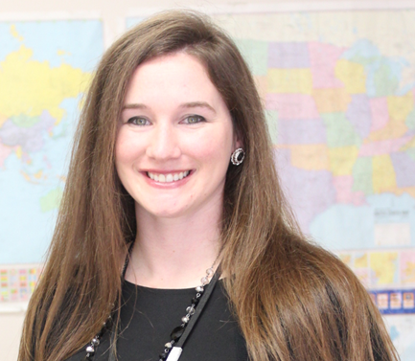
Basic Introductions
Name: Dr. Sumner
Nickname: Diesel
Age: 35
Grade Level: Graduate Level
Class Period: 3rd Period
Where you are from: Alton, Illinois

Slide 5
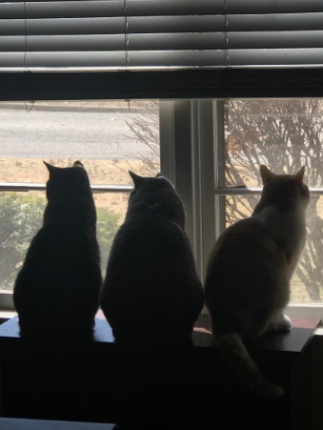
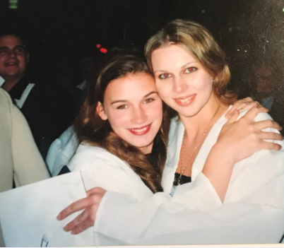
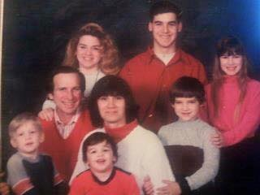
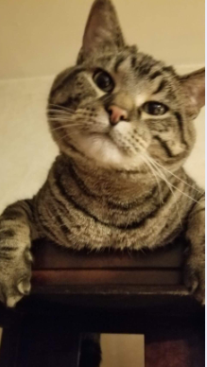
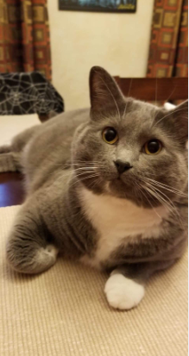
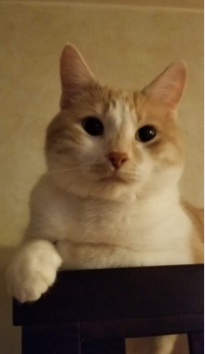
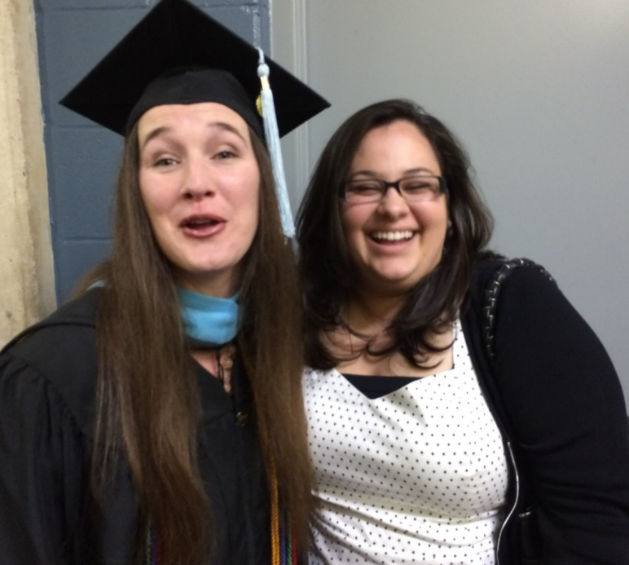
Family, Friends and Pets
I come from a big family. I have 4 brothers and one older sister.
My family loves to get together during the holidays and celebrate. I don’t get much time with my friends because I am still going to grad school.
My family and friends mean the world to me. They are the most caring and loyal people I know. I would not be where I am today without them. They have been especially supportive with me since my surgery.
I have three cats, Machado, Donaldson and Aliester.

Slide 6
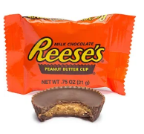
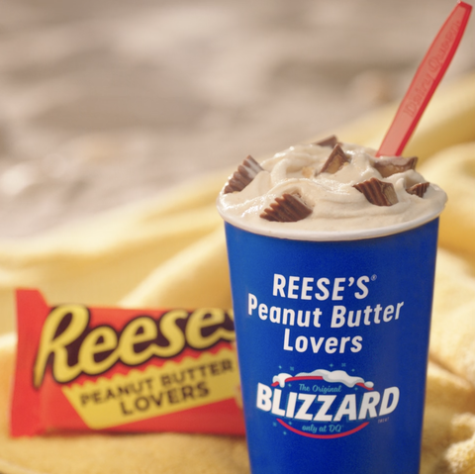
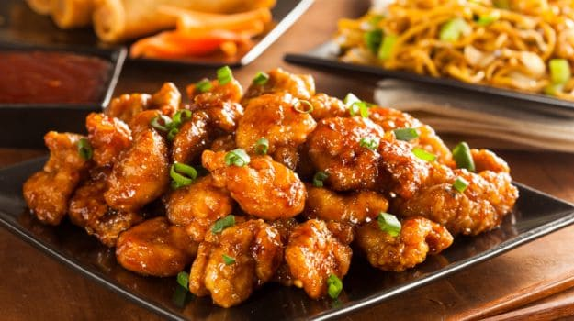
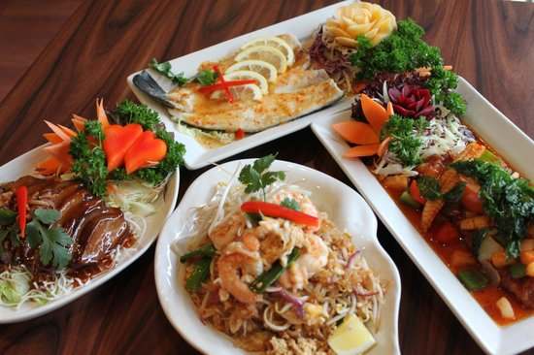
Snacks and Treats
What are your favorite snacks and treats? If you could have an endless supply of food, which would you choose?
I love Reese’s peanut butter cups and ice cream. So of course I love peanut butter cup blizzards from Dairy Queen. I love Chinese food as well.
If I could have an endless supply of food, I would definitely have to choose Thai food!

Slide 7
Netflix and Chill
What are your favorite movies or shows to watch?
I love the movie “The Labryrinth” and I love the show “Stranger Things” and “Sugar Rush”.

Slide 8
Music
Choose one or two songs that represent who you are as an individual.
Display the link of the music videos/songs below.
I love the movie “Pretty in Pink” and I am a big 80s fan so the song “If You Leave” definitely represents my love for the 80s.
https://www.youtube.com/watch?v=fDFmRETqKTs
I also love classical music so Beethoven’s “Moonlight Sonata” is one of my favorite pieces.
https://www.youtube.com/watch?v=4Tr0otuiQuU

Slide 9
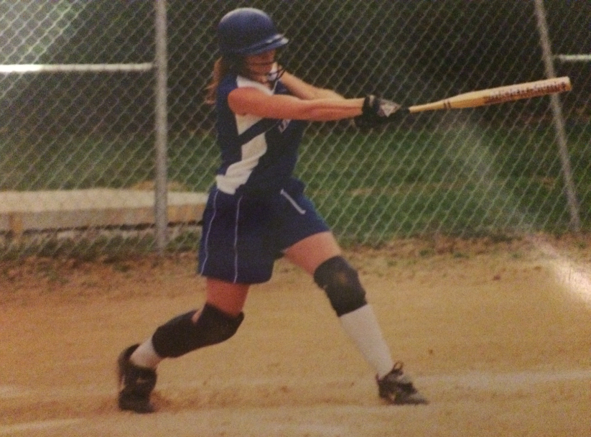
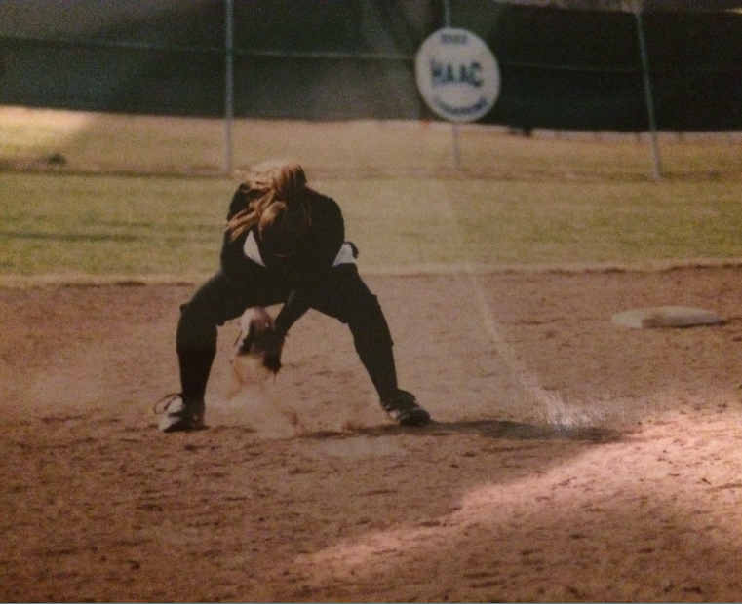
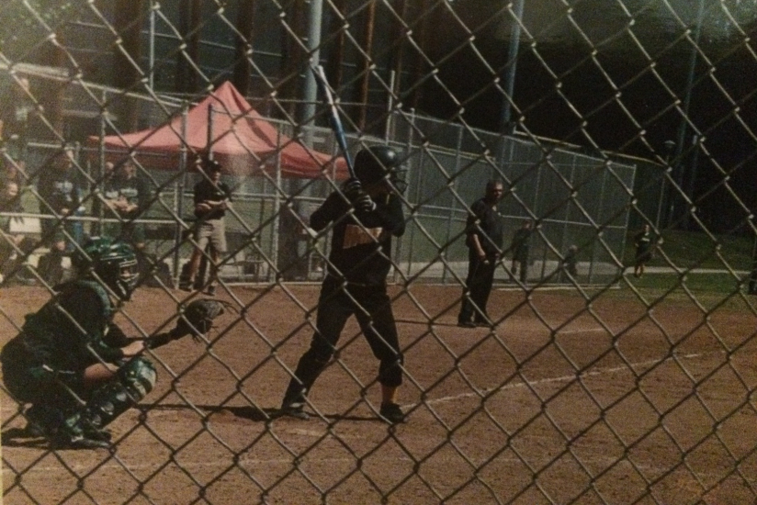
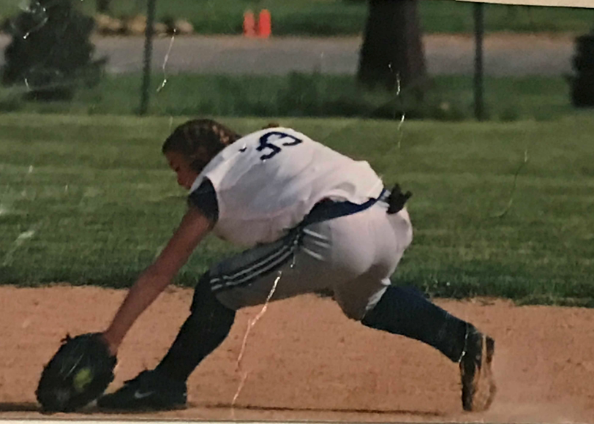
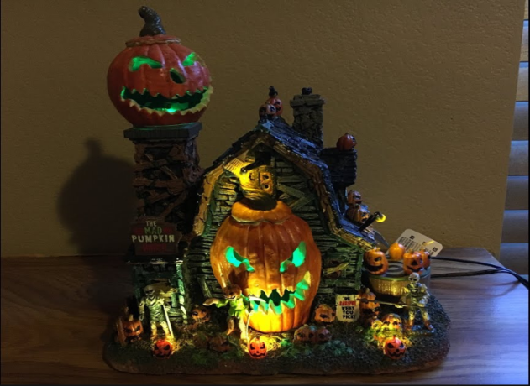
Sports and Hobbies
I love softball! I played softball from 2nd grade all the way through college and in some women’s leagues. It is something I am very passionate about.
Softball was definitely a stress reliever for me and is a big reason why I was able to afford college.
I also collect Halloween houses. Halloween is by far my favorite holiday!

Slide 10
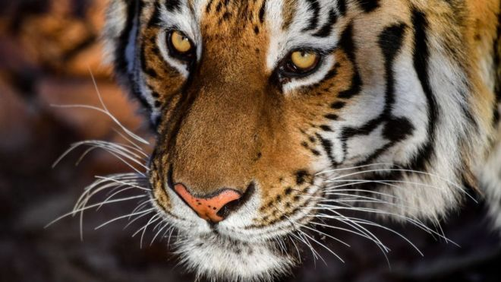
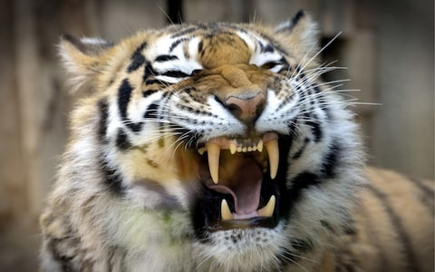
Spirit Animal
My spirit animal is definitely a tiger. I have always loved tigers and it definitely represents my personality. I am very calm and patient; however, there are times when I can display intense behavior when provoked.

Slide 11
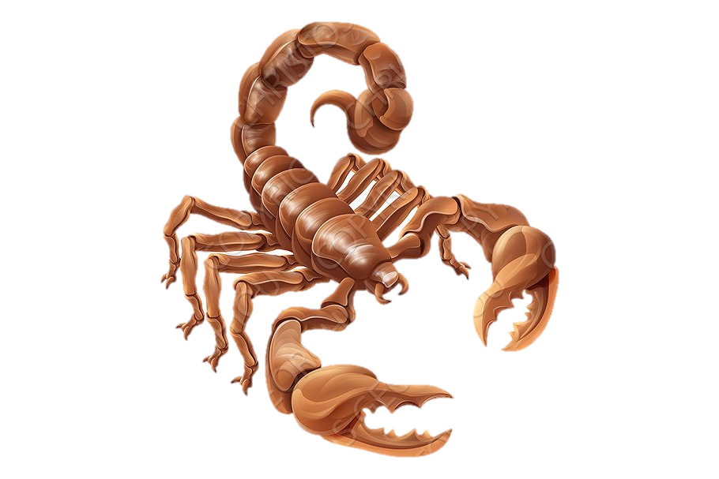
Zodiac Sign
I am a Scorpio. I do not read too much into Zodiac signs but the whole concept is super interesting.
Scorpios can be strong willed and determined, almost to the point of being stubborn. This makes them great competitors, even if they are able to hide this desire to win from you. This also makes Scorpios very dominant, controlling and passionate. Above all else, they are intense about almost everything.

Slide 12
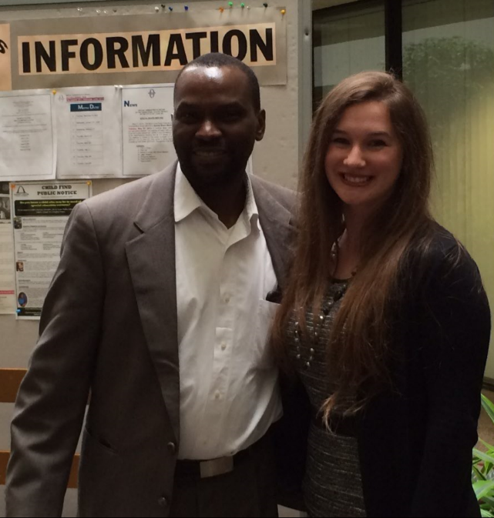
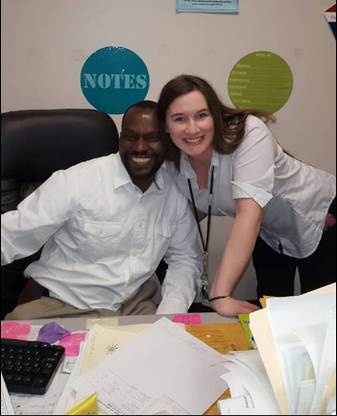
Role Model
Valentine Malumbila is my long-time colleague, friend and companion who has taught me the traits of becoming an influential teacher leader. He has taught me to build leadership capacity within myself as well as others. His South African upbringing in education has given me a deeper philosophical perspective on education.
He is patient, a great listener and is passionate about helping others. He is someone who I really aspire to be like. He is also a big reason why I am the teacher I am today.

Slide 13
Life Slogan
Don’t put the key to your happiness in someone else’s pocket.
The life slogan represents who I am as an individual my entire philosophy in life. I know what I want to do in my life and what I want to accomplish and I do not let any one stand in my way of that.

Slide 14
Future Aspirations (Life Goals)
I would love to graduate from UMSL and pursue working part time in the collegiate setting working with future teachers as an adjunct professor.
What are the steps that you are going to take to make that happen? (List your goals here)
Finish the last three courses of my 2nd Masters Program
Sign up for my Action Research Course in the Spring
Conduct Research and Write Dissertation
Network and make connections with current professors at UMSL
Update my resume
Begin applying for adjunct positions

Slide 15
Career Goals
I would love to become an Academic Instructional Coach working with teachers. I would also like to complete my certification in becoming a School Administrator.
What are the steps that you need to take to accomplish this career? (List your steps here)
Apply for Reading Certification through DESE
Begin the process of the Administration certification through Lindenwood. Complete the first assessment (the performance event in the fall) and take the second assessment, the written exam, in the spring.
Apply for School Administration Certification through DESE
Update Resume
Begin networking with SLPS School District Administrators
Apply for Academic Instructional Coach positions

Slide 16
Learning Styles
Here is a list of learning styles for you to choose from:
I am definitely a visual, auditory and verbal learner. When I see things in a visual way (graphic organizers, charts or pictures), I retain things much easier. I also learn better when I can hear someone describing the information while I am looking at the visual prompt. Lastly, it is much easier for me to understand difficult concepts if I am able to talk through the problem with a professor or with my colleagues.
How can I make the learning environment better for you? Further explain. (For example do you like: Group Work, Collaborative Work, Individualized Work, Hands-On Activities, Projects, Writing, Class Discussions)
I love doing collaborative work; however, I work better with partners rather than with groups of four. I love writing and class discussions as well. I understand directions better if they are written down for me rather than verbally explained.

Slide 17
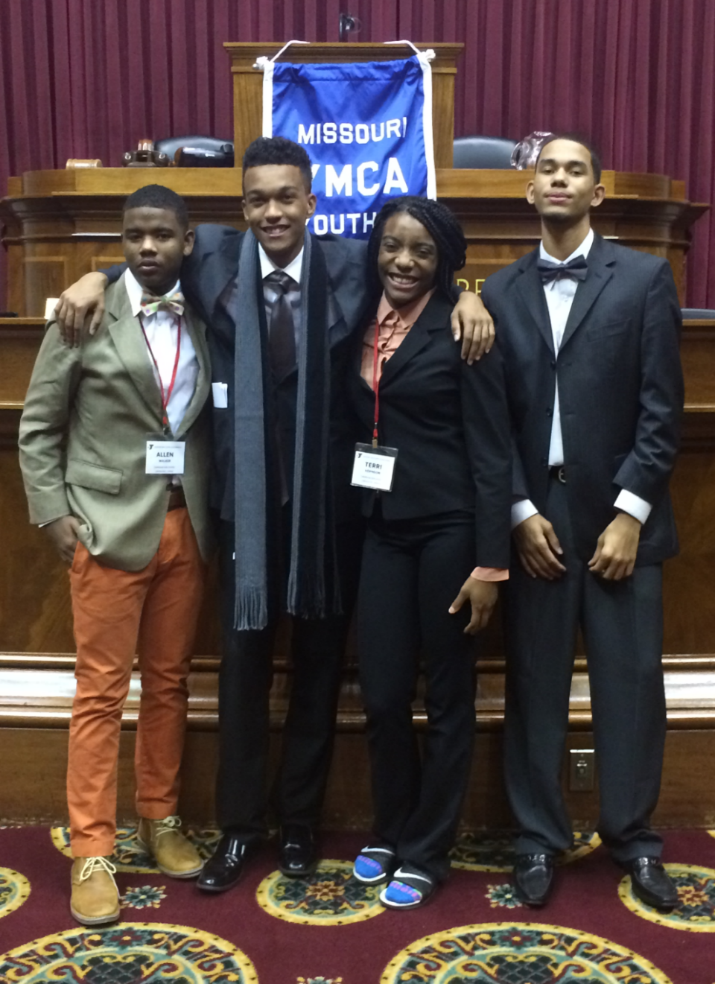
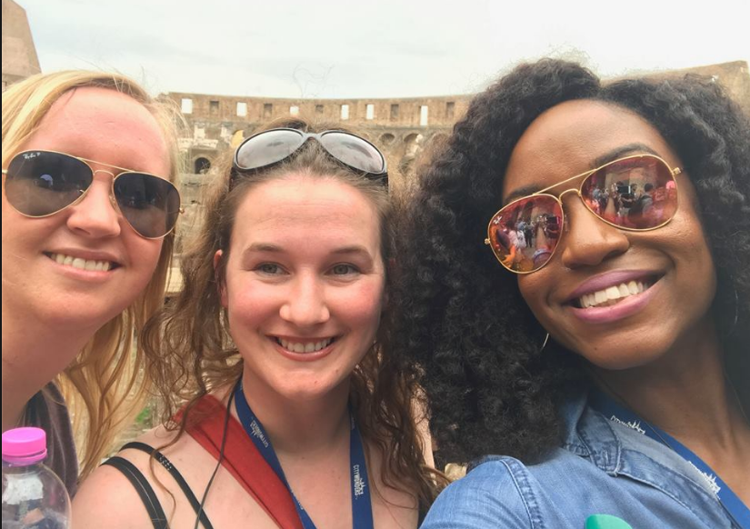
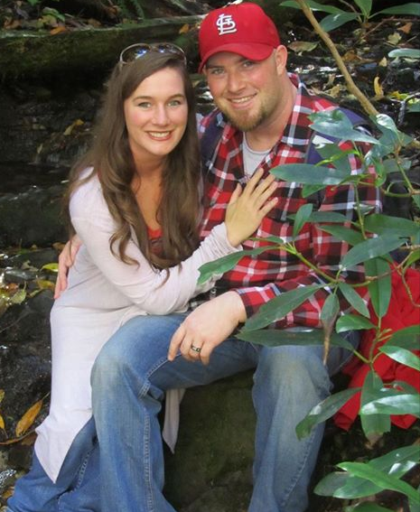
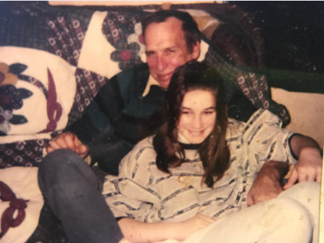
Create a Collage

Slide 18
Submission Directions
Email your finished Digital Blog to diannasumner3@gmail.com

